Slide 1

Design and Development of a Smart Electronic Pen
Group Members
Haq Nawaz (20P-0057)
Noman Yousaf (20P-0614)
Aqil Umar (19P-0034)
Project Supervisor
Dr. Ali Sayyed

Slide 2
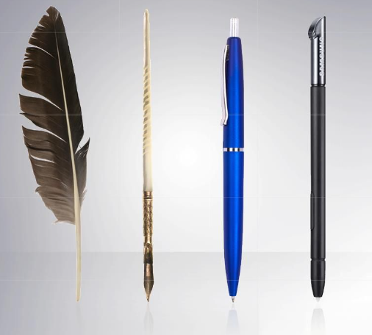
Introduction
The Timeless Legacy of Writing Tool
The pen is an ageless tool that has recorded our history, shared thoughts, and remains a symbol of expression and communication.
History and Importance:
Old pens, like feathers or reeds, helped write our history, share ideas, and connect people through the power of writing.
The Smart Electronic Pen Revolution
From ancient quills to today's Smart Electronic Pen, we blend history with the future, keeping the magic of writing alive in the digital era .

Slide 3
Motivation
- Efficiency in Note-Taking:
Traditional methods are disorganized; the Smart Pen streamlines and organizes notes.
- Comprehensive Recording:
Conventional pens lack depth in recording; the Smart Pen captures audio synchronously, enriching the note-taking experience.
- Adaptability to Modern Lifestyles:
Bulky notebooks hinder adaptability; the compact Smart Pen fits diverse scenarios for on-the-go use.
- Meeting Evolving User Needs:
Technology evolves; the Smart Pen adapts to users' changing needs in education, business, and personal note-taking.

Slide 4
Problem Statement
Note-taking worldwide faces challenges due to outdated methods. Using pen and paper often leads to disorganized and hard-to-manage information. Traditional pens fall short in capturing the depth of discussions, limiting users in recording important details. Bulky notebooks further hinder note-taking adaptability, making it impractical for various settings. Recognizing these global issues, our project, the Smart Electronic Pen, strives to revolutionize note-taking by offering a solution that efficiently organizes handwritten content, records comprehensive audio, and adapts seamlessly to different scenarios.

Slide 5
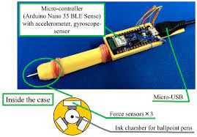
Solution
Effortless Digitization:
Convert handwritten notes to digital instantly, anywhere, on any surface.
Synchronized Audio:
Remember the "why" behind your notes with clear audio recordings linked to every word.
Seamless Transfer:
Securely move notes and recordings to your computer or cloud for easy access and organization.
Compact & Portable:
Ditch bulky notebooks! The Smart Pen fits your pocket, ready whenever inspiration strikes.
Modernize Tradition:
Embrace the familiar comfort of a pen with the efficiency and power of digital technology.
Boost Learning & Productivity:
Enhance your recall, organize effortlessly, and unlock new possibilities for note-taking.

Slide 6
Scope of the project
1: Design and develop algorithm to capture moment of pen and translate it into notes,
preferably in image foam.
2: Audio recording and alignment of audio recoding with notes.
3: Testing and usability analysis of the system.

Slide 7
Goals
4) Quality education
12) Responsible consumption and production
13) Climate action

Slide 8
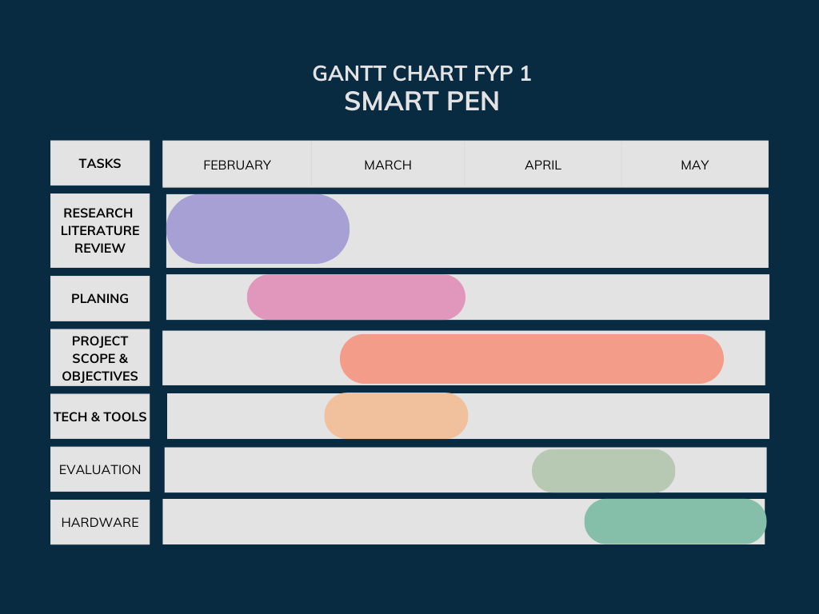
Objectives

Slide 9
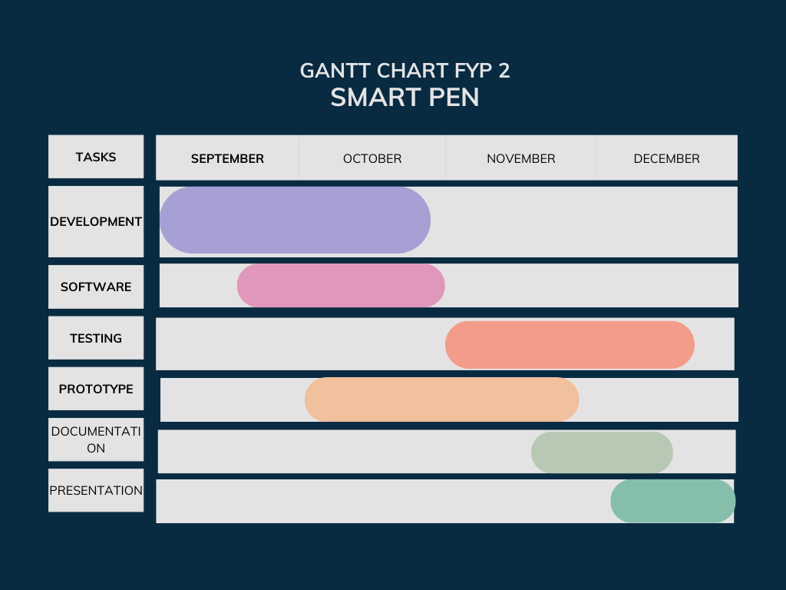
Objectives

Slide 10
Expected Result
A fully operational prototype of a Smart Electronic Pen
A real-time digitization of handwritten notes that is seamless
Coordinates with audio recordings to create thorough documentation
Sleek, ergonomic design for portability and versatility
User-friendly interface controls and robust connectivity options
Transforms conventional traditional note-taking methods for modern needs

Slide 11
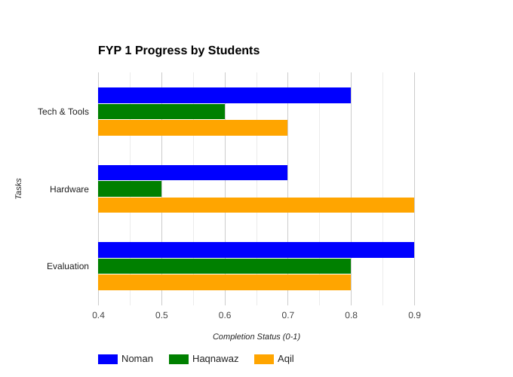
Team Work

Slide 12
References
1. https://www.researchgate.net/
2. http://creativecommons.org/
3. https://www.academia.edu/
4. https://ieeexplore.ieee.org/
5. https://dl.acm.org/

